Slide 1
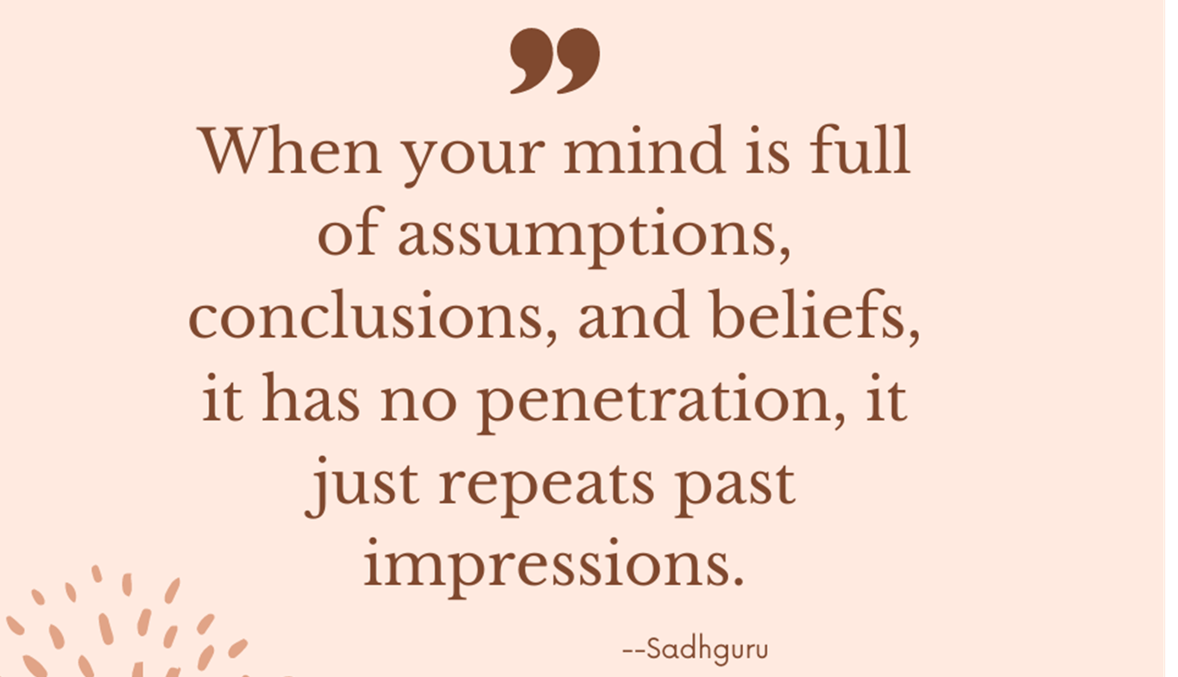
GBT0002
Critical Thinking and Problem Solving Skills
Week 1

Slide 2
Let’s Discuss
In your own word, what does “ Critical Thinking” mean?
Notes:
🍐 This is a Pear Deck Text Slide
🍐 To edit the type of question, go back to the "Ask Students a Question" in the Pear Deck sidebar.

Slide 3
John Dewey- Reflective Thinking
“Active, persistent, and careful consideration of a belief or supposed form of knowledge in the light of the grounds which support it and the further conclusions to which it tends” (Dewey, 1990, p.9)

Slide 4
Other definitions of “Critical Thinking”
Robert Ennis “ Critical thinking is reasonable, reflective thinking that is focused on deciding what to believe or do” (Cf. Norris and Ennis, 1989)
Richard Paul “ Critical thinking is that mode of thinking-about any subject, content or problem- in which the thinker improves the quality of his or her thinking by skilfully taking charge of the structures inherent in thinking and imposing intellectual standards upon them (Paul, Fisher and Nosich, 1993, p.4)
Notes:
Analogy of basketball

Slide 5
Things to read for the next lesson:-
Egocentrism
Sociocentrism
Relativistic thinking
Unwarranted assumptions
Wishful thinking

Slide 6
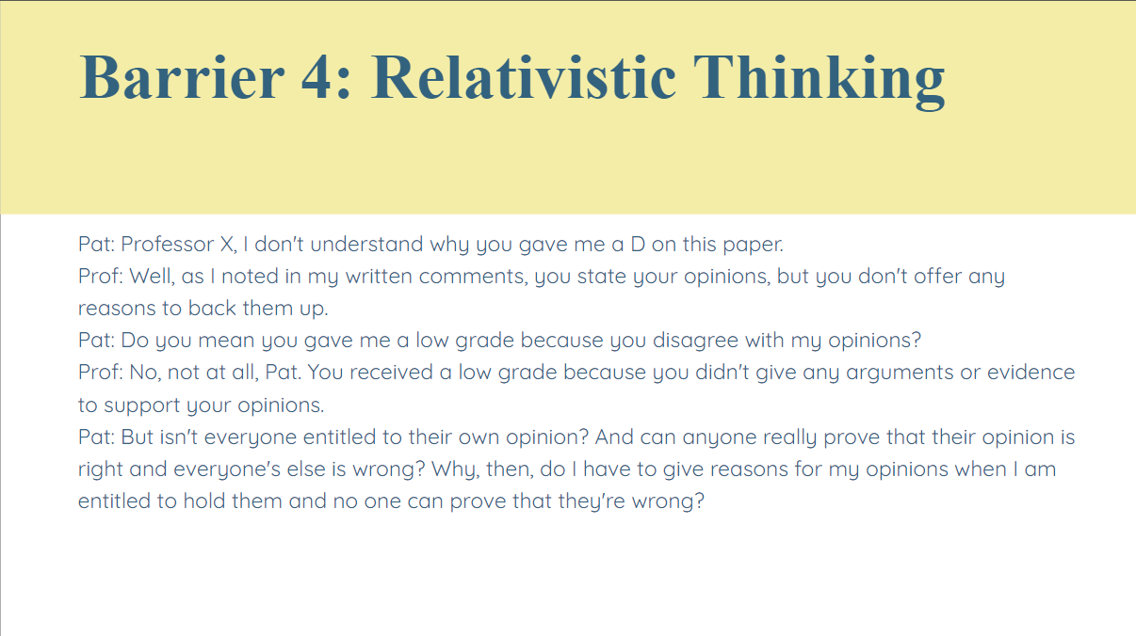

Slide 7
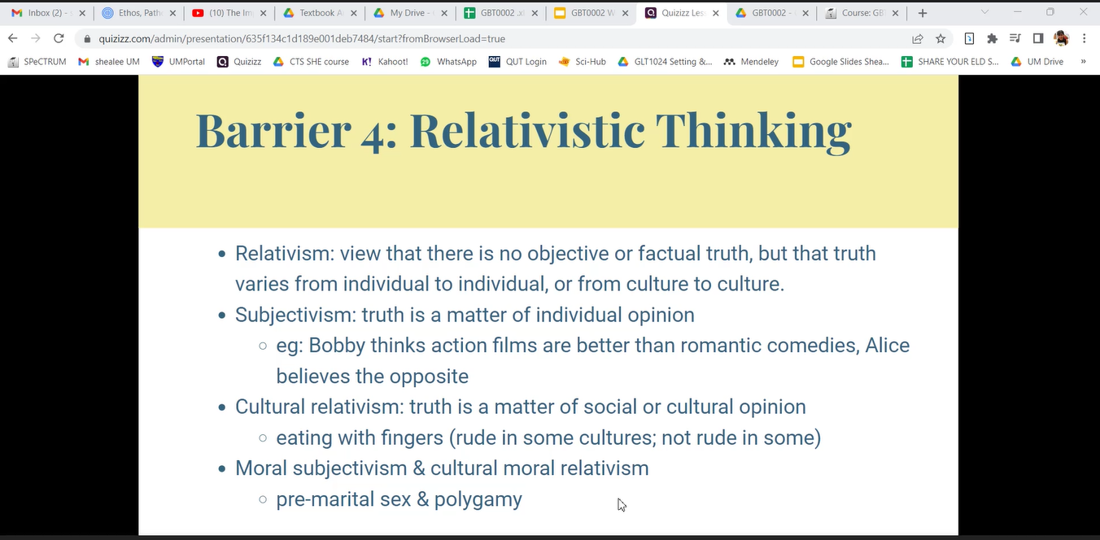

Slide 8
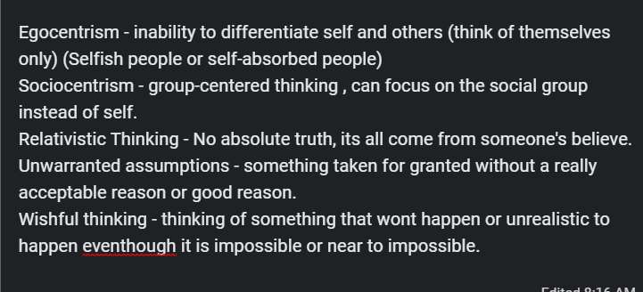

Slide 9
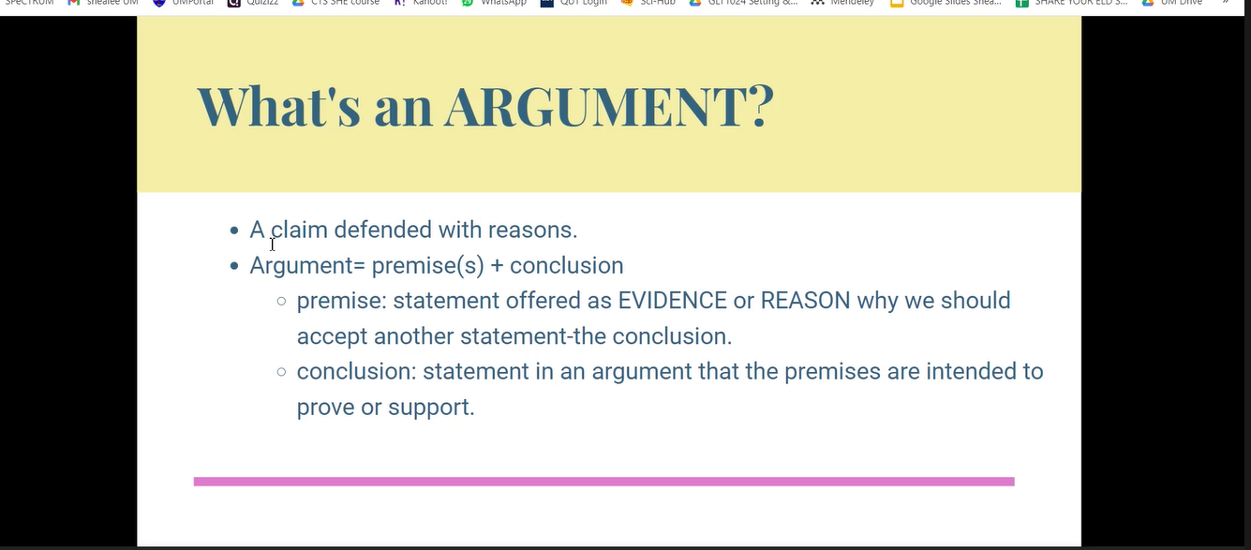

Slide 10
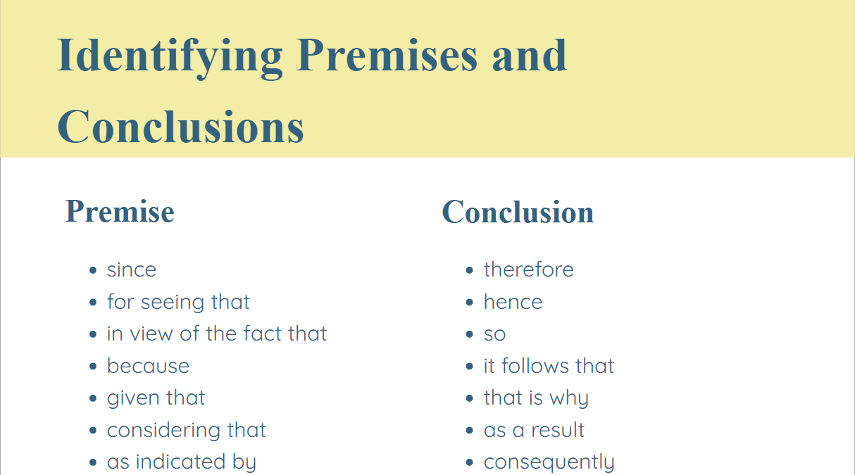

Slide 11
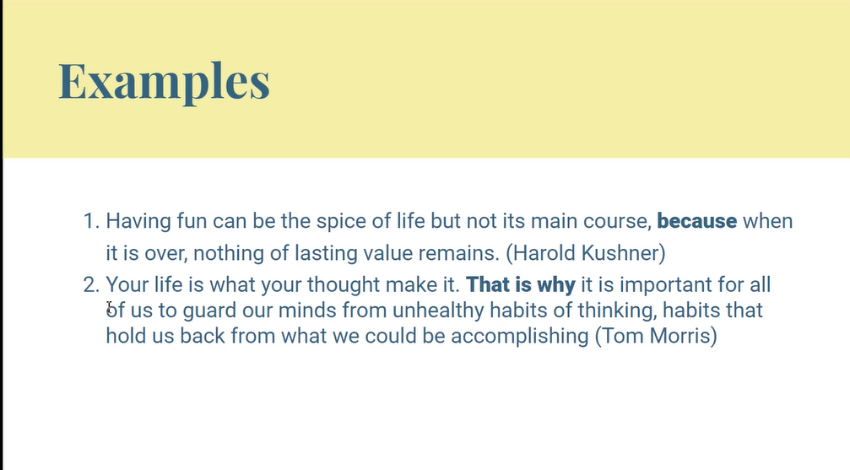

Slide 12
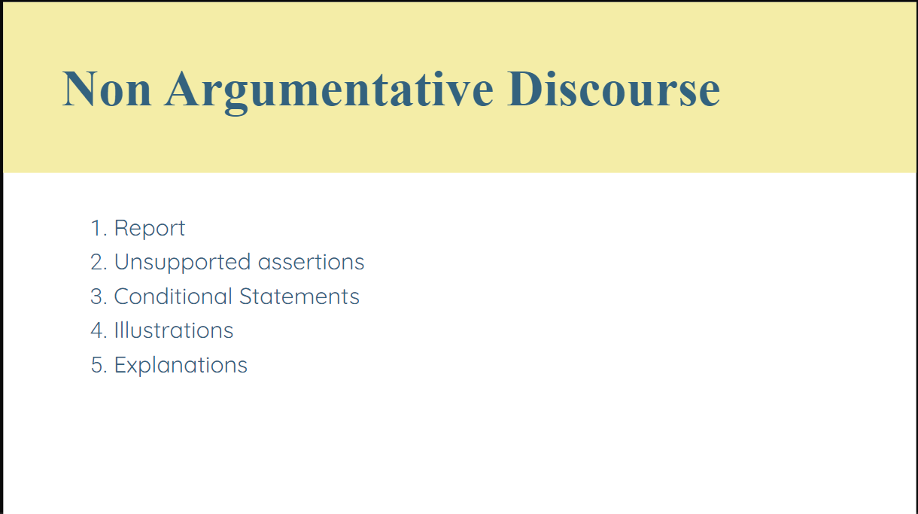

Slide 13
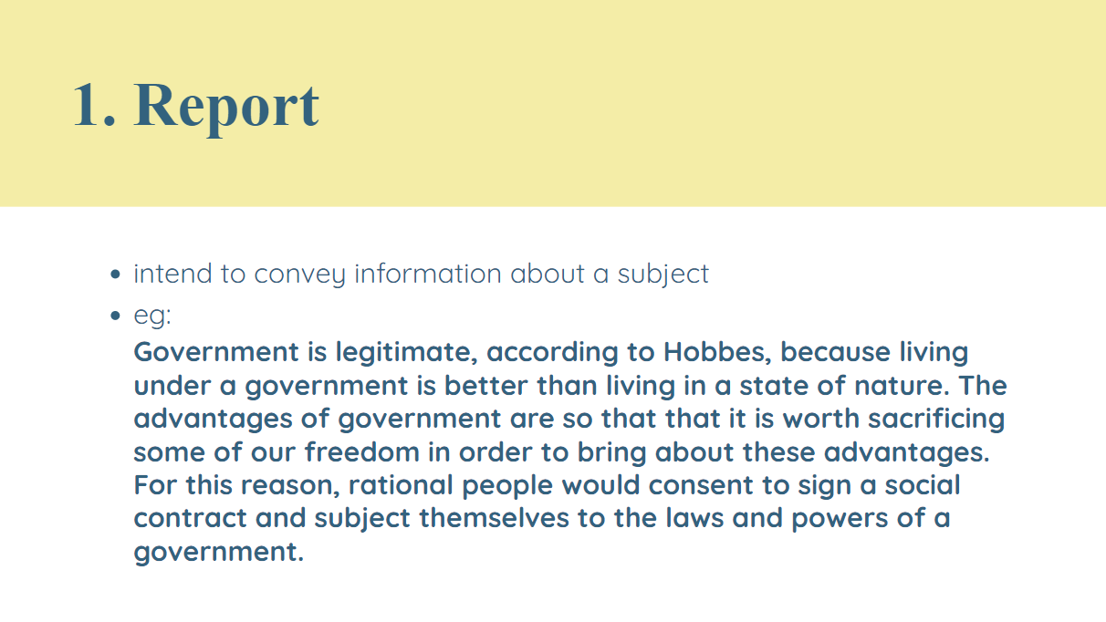

Slide 14
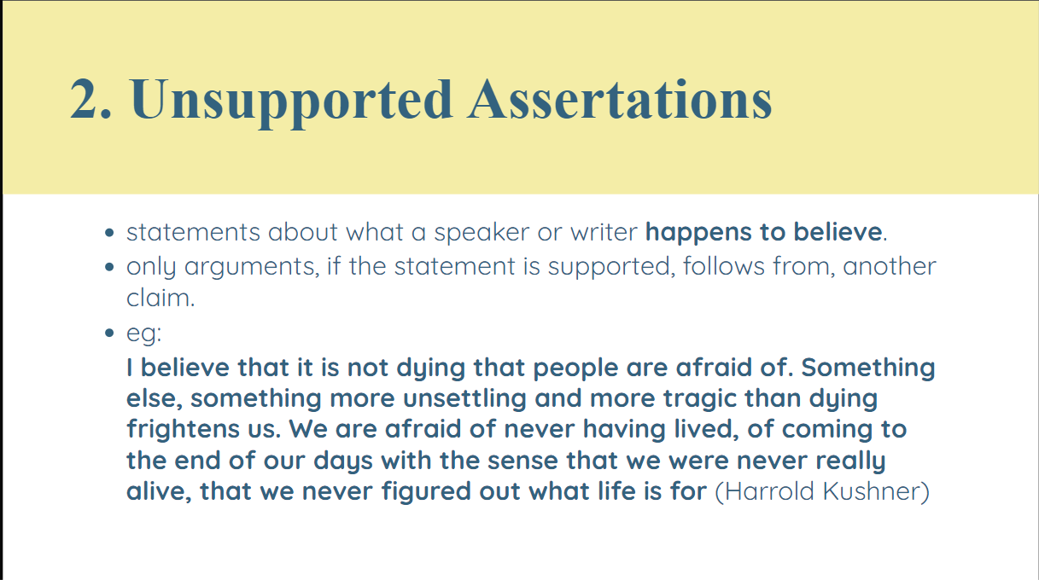

Slide 15
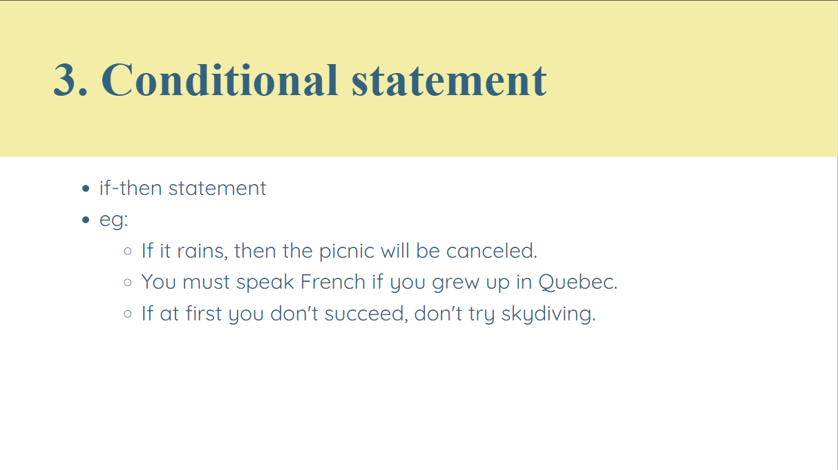

Slide 16
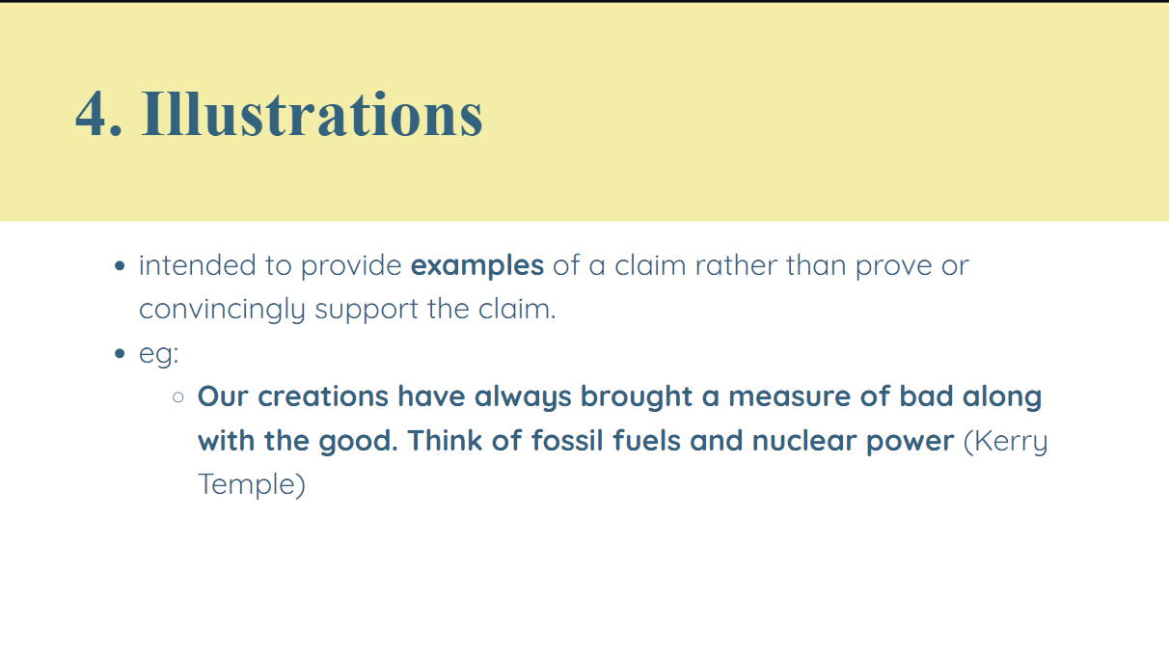

Slide 17
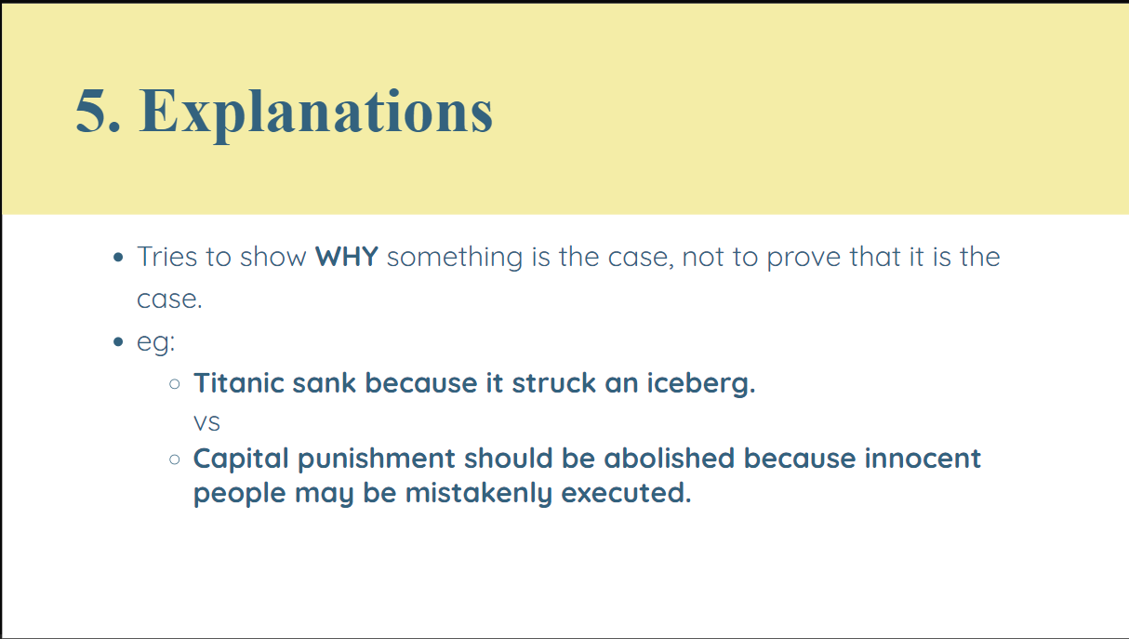

Slide 18
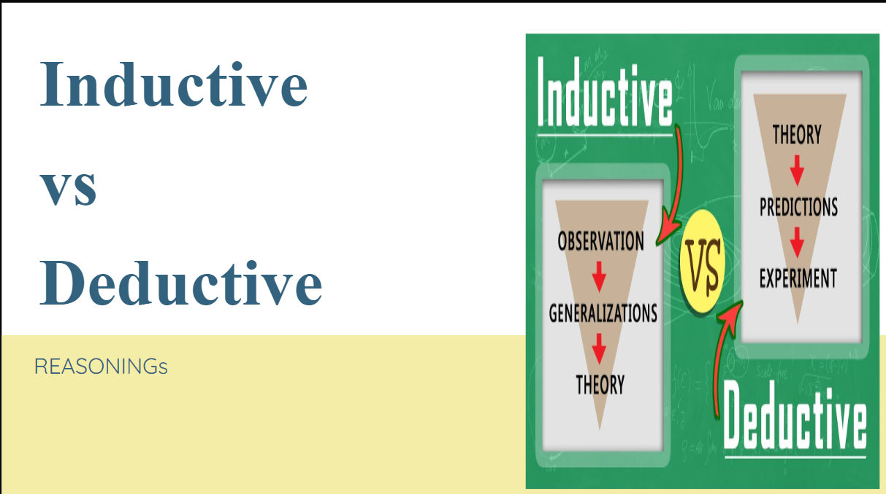

Slide 19
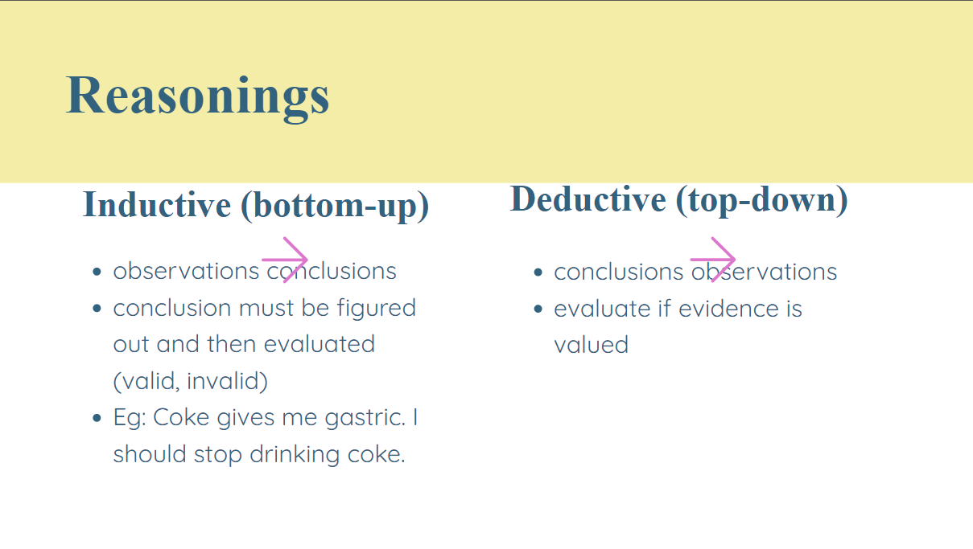

Slide 20
